Slide 1
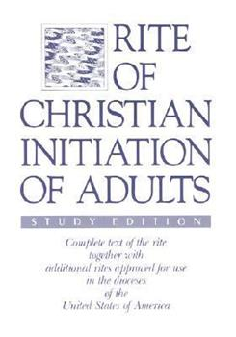
How to read the Rite

Slide 2
WHAT IS A RITE? A symbolic action observed in a particular manner

Slide 3
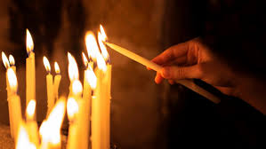
Rites Rituals Social Practices Repeated Regularly

Slide 4
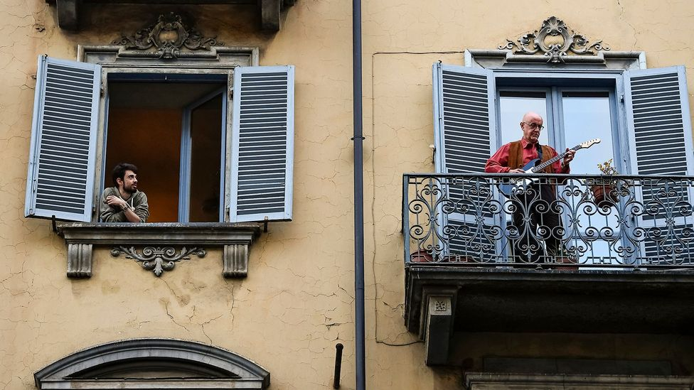

Slide 5
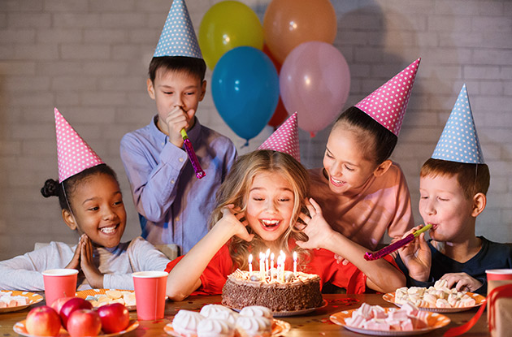

Slide 6
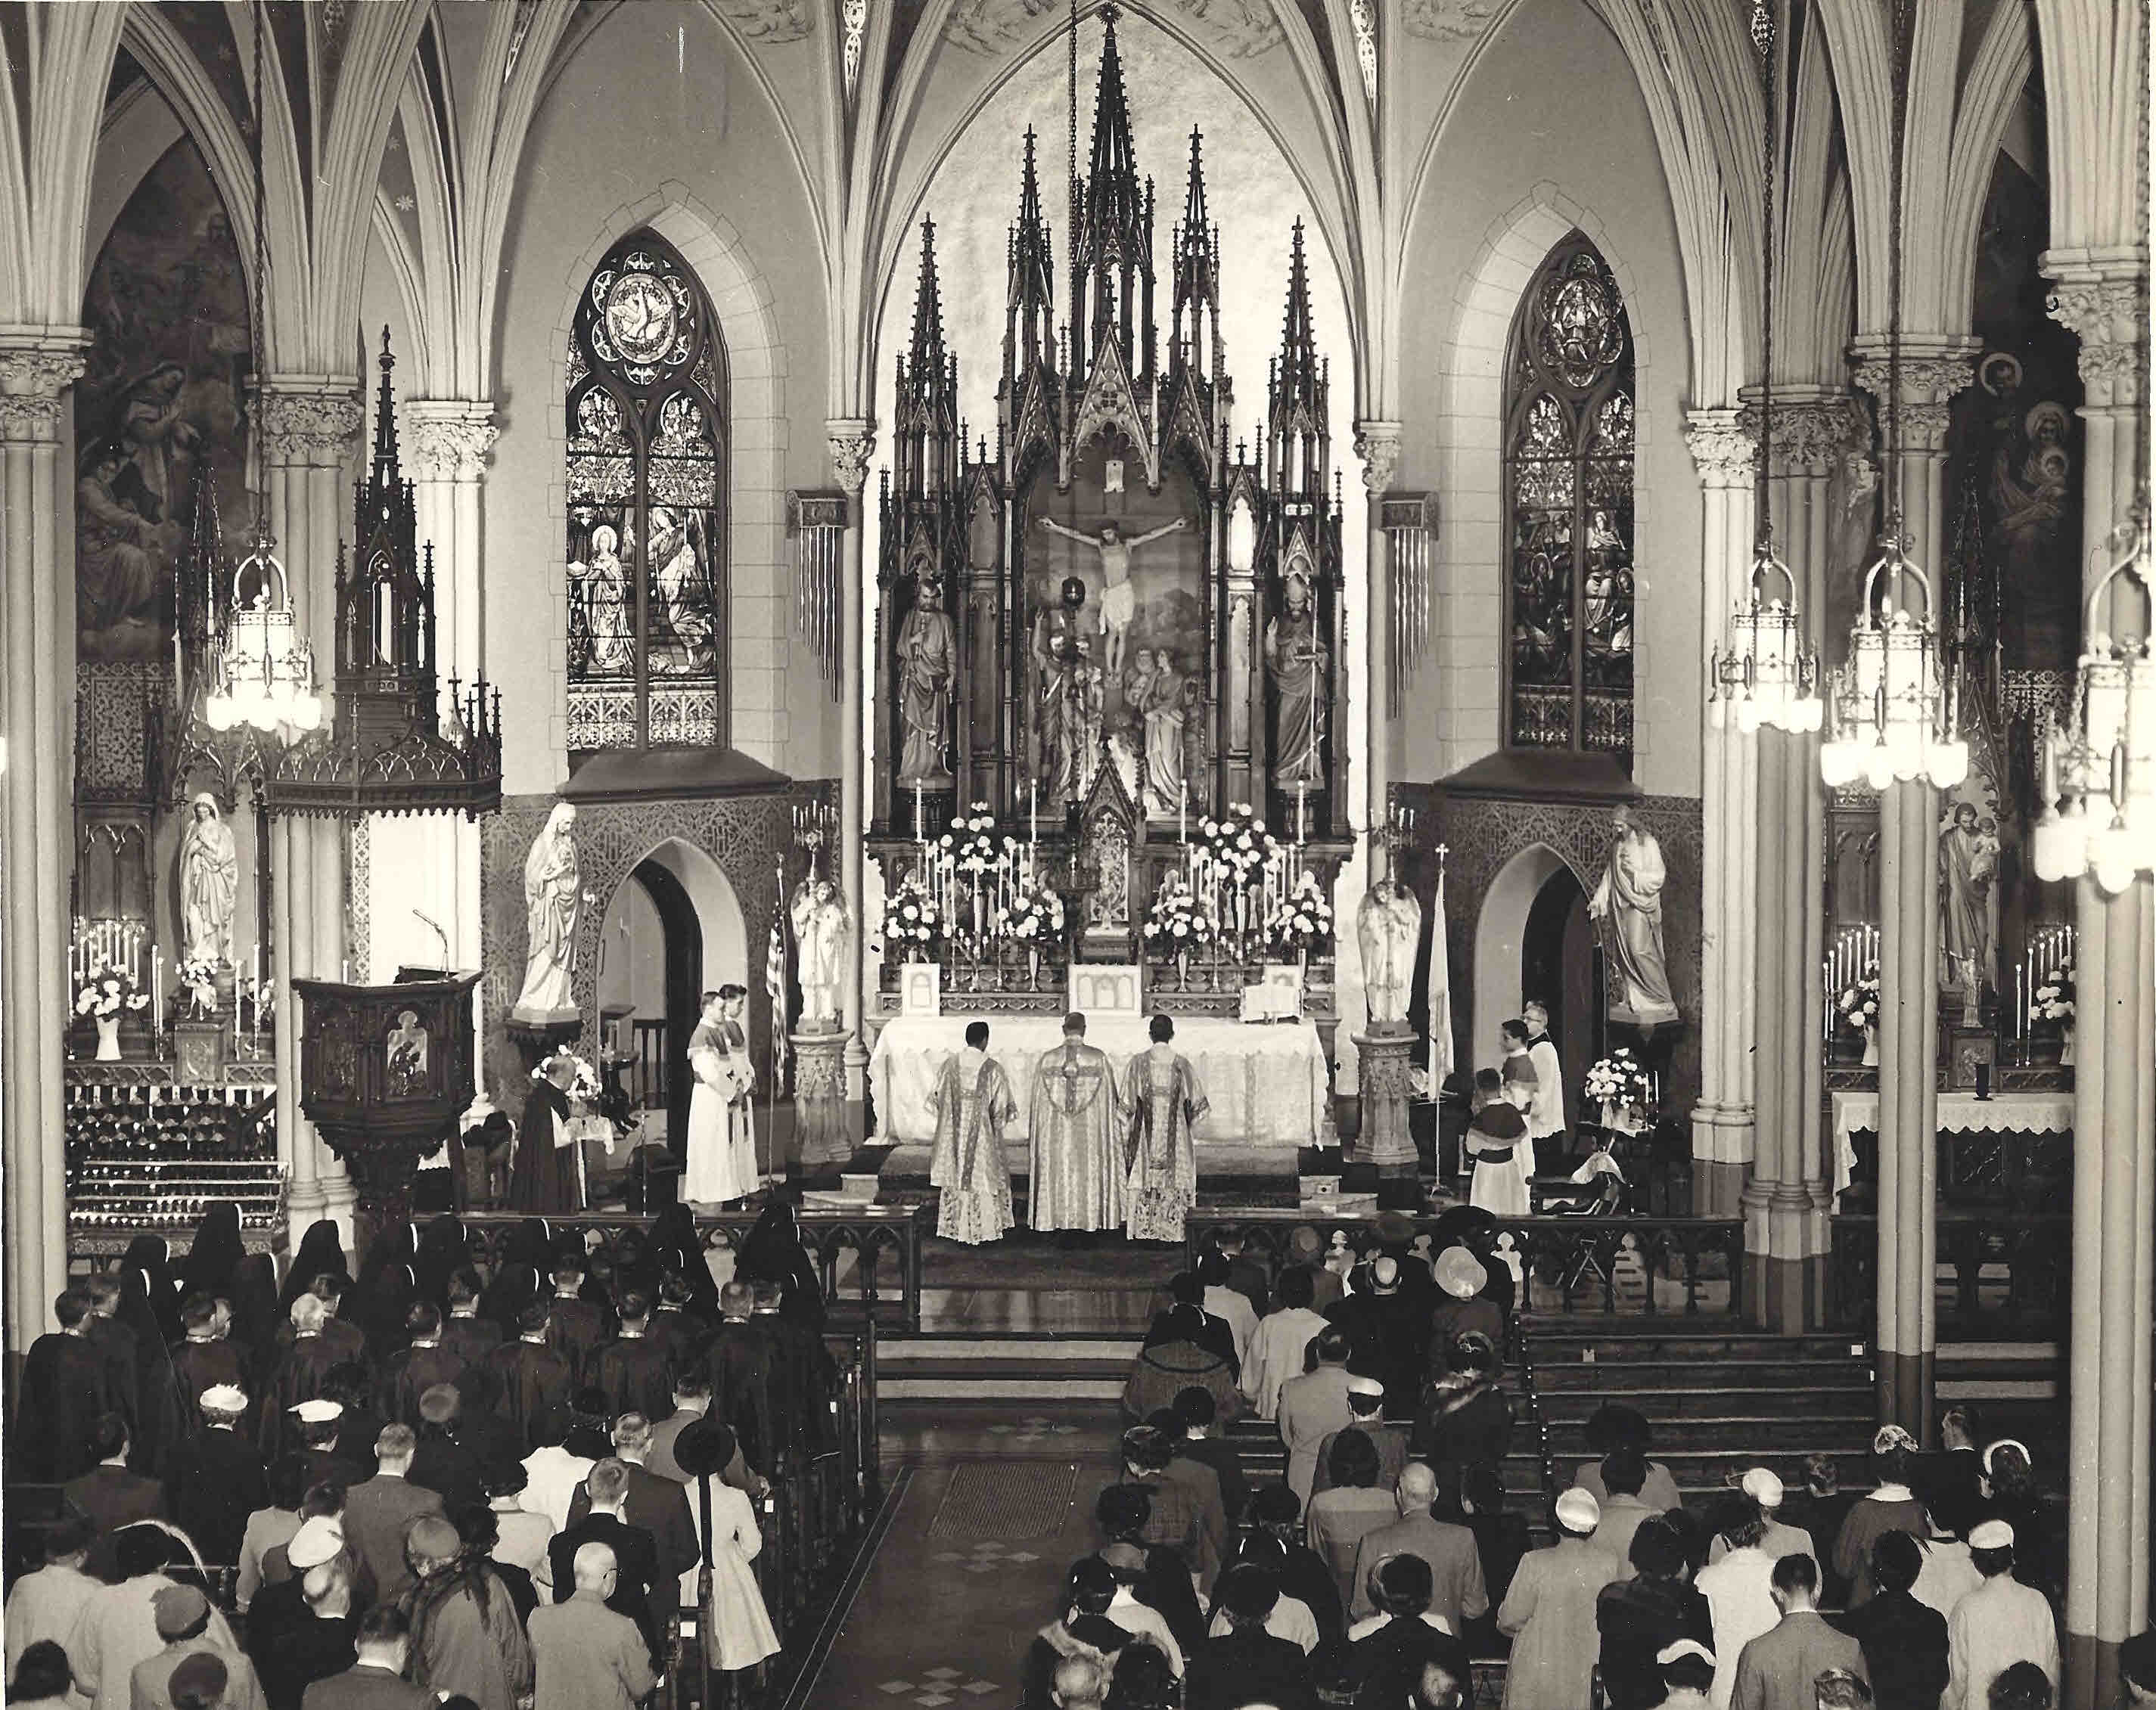

Slide 7
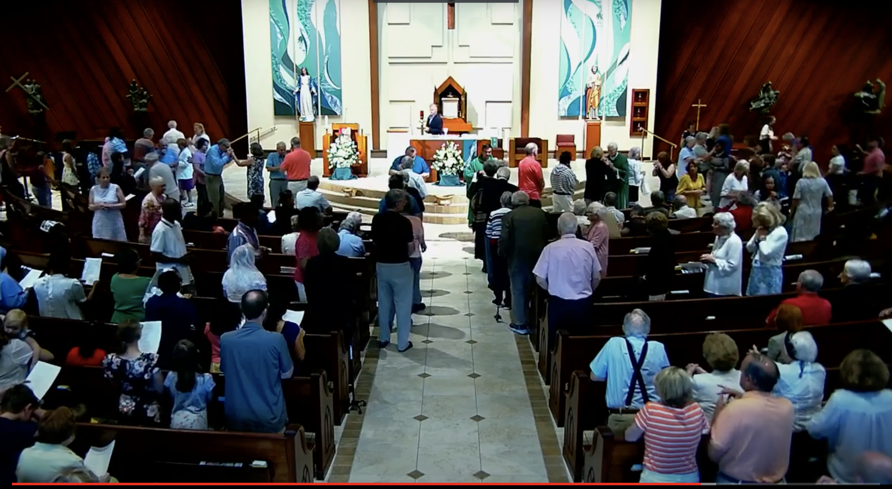

Slide 8
Adapt Pastoral Insofar as possible in these Or Similar words or something similar

Slide 9
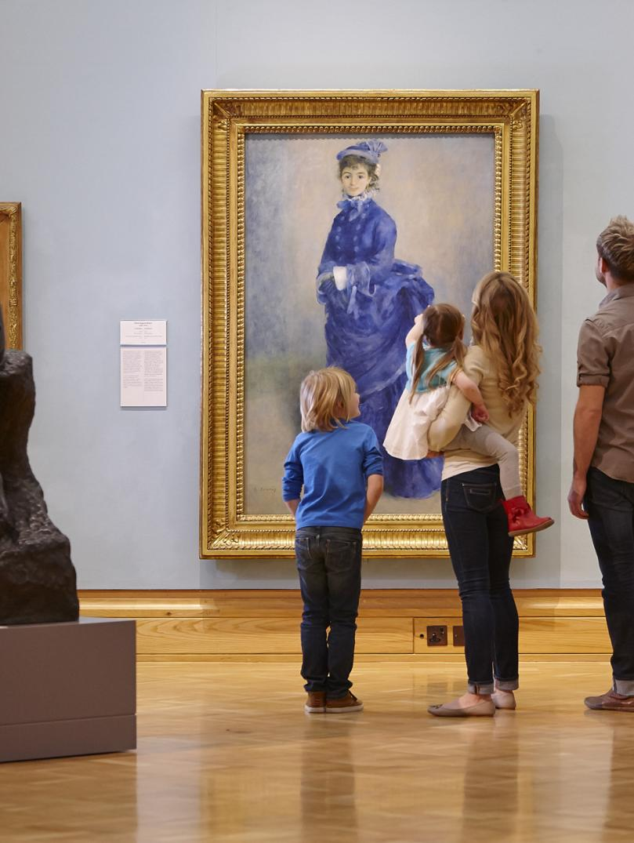

Slide 10
Praenotanda - Introduction
Texts that give the pastoral
and theological meaning
of the rites.
Tell what the Church is
doing/intending with
this rite.

Slide 11
Introduction to the Rite of Christian Initiation of Adults
Paragraphs 1-35
1.The rite of Christian initiation presented here is designed for adults who, after hearing the mystery of Christ proclaimed, consciously and freely seek the living God and enter the way of faith and conversion as the Holy Spirit opens their hearts.
4.The initiation of catechumens is a gradual process that takes place within
the community of the faithful.
5. The rite of initiation is suited to a spiritual journey of adults that varies according to the many forms of God’s grace, the free cooperation of the individuals, the action of the Church and the circumstances of time and place.
8. The whole initiation must bear a markedly paschal character, since the Initiation of Christians is the first sacramental sharing in Christ’s dying and Rising.
9.The people of God, as represented by the local Church, should understand and show by their concern that the initiation of adults is the responsibility of all the baptized.

Slide 12
Acceptance Into the Order of Catechumens
41. The rite that is called the rite of acceptance into the order of catechumens is of utmost importance. Assembling publicly for the first time, the candidates (inquirers) who have completed the period of the precatechumenate declare their intention to the Church and the Church in turn, carrying out its apostolic mission, accepts them as persons who intend to become its members. God showers his grace on the candidates, since the celebration manifests their desire publicly and marks their reception and first consecration by the Church.

Slide 13
Acceptance Into the Order of Catechumens
42. The prerequisite for making this first step is that the beginnings of the spiritual life and the fundamentals of Christian teaching have taken root in the candidates (inquirers). Thus there must be evidence of the first faith that was conceived during the period of evangelization and precatechumenate and of an initial conversion and intention to change their lives and to enter into a relationship with God in Christ. Consequently, there must also be evidence of the first stirrings of repentance a start to the practice of calling upon God in prayer, a sense of the Church, and some experience of the company and spirit of Christians through contact with a priest or with members of the community. The candidates (inquirers) should also be instructed about the celebration of the liturgical rite of acceptance.

Slide 14
Acceptance Into the Order of Catechumens
44. The rite will take place on specified days during the year (see no. 18)
that are suited to local conditions.
#18. The following should be noted about the time of celebrating the rite of acceptance into the order of catechumens.
It should not be too early, but should be delayed until the candidates (inquirers), according to their own dispositions and situation, have had sufficient time to conceive an initial faith and to show the first signs of conversion.
In places where the number of candidates (inquirers) is smaller than usual, the rite of acceptance should be delayed until a group is formed that is sufficiently large for catechesis and the liturgical rites.
Two dates in the year or three if necessary, are to be fixed as the usual times for carrying out this rite.
Should = recommended but not required.

Slide 15
Acceptance Into the Order of Catechumens
44. Continued: The rite consists in the reception of the candidates (inquirers), the celebration of the word of God, and the dismissal of the candidates (inquirers) celebration of the eucharist may follow.
45. It is desirable that the entire Christian community or some part of it, consisting of friends and acquaintances, catechists and priests, take an active part in the celebration. The presiding celebrant is a priest or a deacon. The sponsors should also attend in order to present to the Church the candidates (inquirers) they have brought.
May does not mean must.

Slide 16
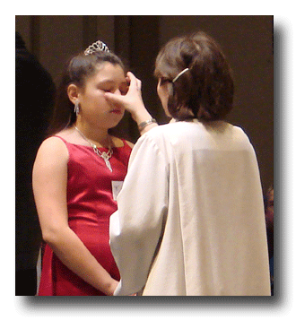
Acceptance Into the Order of Catechumens
48. The candidates (inquirers), their sponsors, and a group of the faithful gather outside the church (or inside at the entrance or elsewhere) or at some other site suitable for this rite.

Slide 17
Acceptance Into the Order of Catechumens
48. The candidates (inquirers), their sponsors, and a group of the faithful gather outside the church (or inside at the entrance or elsewhere) or at some other site suitable for this rite.

Slide 18
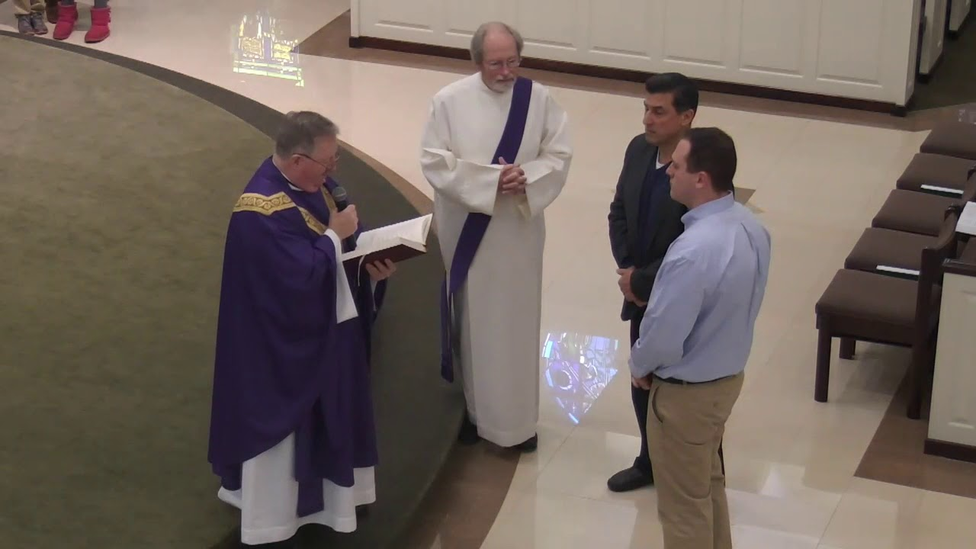
Acceptance Into the Order of Catechumens
50. Unless the candidates (inquirers) are already known to all present, the celebrant asks for or calls out their given names. The candidates answer one by one, even if, because of a large number, the question is asked only once. One of the following or something similar may be used.
The celebrant asks:
What is your name?
Candidate:
N.

Slide 19
Acceptance Into the Order of Catechumens
The celebrant continues with the following questions for the individual candidates (inquirers) or, when there are a large number, for the candidates (inquirers) to answer as a group. The celebrant may use other words than those provided in asking the candidates (inquirers) about their intentions and may let them answer in their own words: for example, to the first question, “What do you ask of the Church of God?” or “What do you desire?” or “For what reason have you come?”, he may receive answers as “The grace of Christ” or “Entrance into the Church” or “Eternal life” or other suitable responses. The celebrant then phrases his next question according to the answer received.
Celebrant:
What do you ask of God’s Church?
Candidate:
Faith
Celebrant:
What does faith offer you?
Candidates:
Eternal life.

Slide 20
Acceptance Into the Order of Catechumens
Principals for reading a rite:
Read the rite and ask:
What is the purpose of the rite?
What is the meaning of the rite?
What did you learn about the rite that you didn’t know before?
What did you notice?
Pick out words like “may,” “should,” “or,” “something similar”
What adaptations might you make that enhance the
purpose and the meaning of the rite?
(Placement? Dialogue? )
What doesn’t the rite talk about?

Slide 21
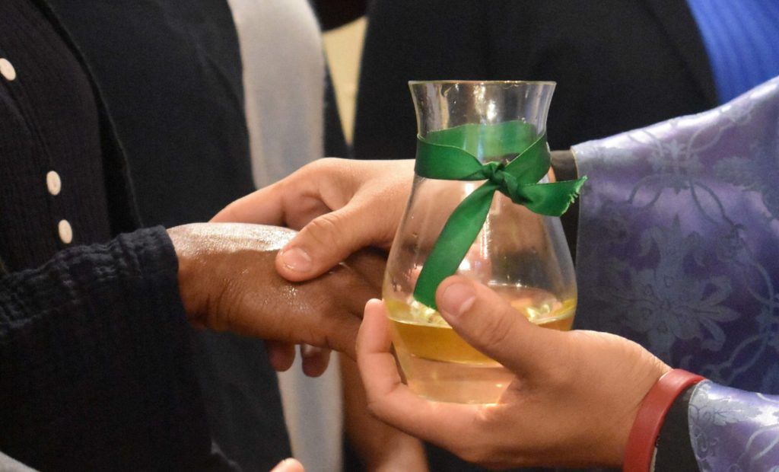
Anointing of the Catechumens
98. During the period of the catechumenate, a rite of anointing the catechumens, through the use of the oil of catechumens, may be celebrated wherever this seems beneficial or desirable. The presiding celebrant for such a first anointing of the catechumens is a priest or deacon.
99. Care is to be taken that the catechumens understand the significance of the anointing with oil. The anointing with oil symbolizes their need for God’s help and strength so that, undeterred by the bonds of the past and overcoming the opposition of the devil they will forthrightly take the step of professing their faith and will hold fast to it unfalteringly throughout their lives.

Slide 22
Anointing of the Catechumens
100. The anointing ordinarily takes place after the homily in a celebration of the word of God and is conferred on each of the catechumens; this rite of anointing may be celebrated several times during the course of the catechumenate. Further, for particular reasons, a priest or a deacon may confer the anointing privately on individual catechumens.

Slide 23
Anointing of the Catechumens
101. The oil used for this rite is to be the oil blessed by the bishop at the chrism Mass, but for pastoral reasons a priest celebrant may bless oil for the rite immediately before the anointing.
Prayer of Exorcism or Blessing of Oil
102. When anointing with oil already blessed by the bishop, the celebrant first says the prayer of exorcism given as option A (or one of the other prayers of exorcism in no. 94); a priest celebrant who for pastoral reasons chooses to bless oil for the rite uses the blessing given as option B.

Slide 24
Anointing of the Catechumens
Anointing
103. Facing the catechumens, the celebrant says:
We anoint you with the oil of salvation in the name of Christ our Savior.
May he strengthen you with his power, who lives and reigns for ever and ever.
The celebrant anoints each catechumen with the oil of catechumens on the breast or on both hands or, if this seems desirable, even on other parts of the body.
The anointing may be followed by a blessing of the catechumens (no. 97)

Slide 25
Anointing of the Catechumens
Read the rite
What is the purpose of the rite?
(anointing.. strength/wisdom)
What did you learn about the rite that you didn’t know before?
What did you notice? (anoint different parts of the body)
When would you use this rite?
(whenever a crisis occurs)
How would you use this rite?
(at a catechetical session, in the Sunday assembly)
What adaptations might you make?
(extension of hands/music)
Music
Environment

Slide 26
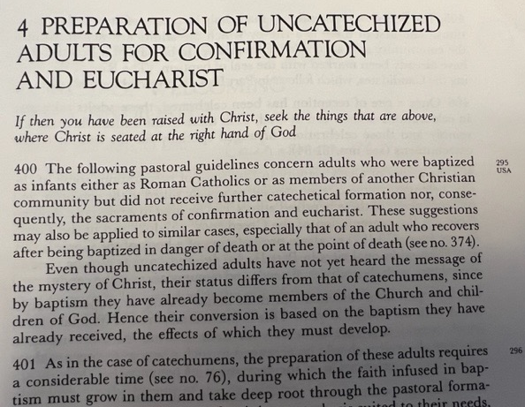

Slide 27
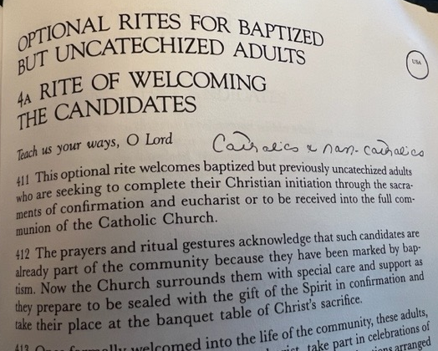

Slide 28
National Statues
14. In order to signify clearly the interrelation or coalescence of the three sacraments which are required for full Christian initiation (canon 84:2), adult candidates, including children of catechetical age, are to receive baptism, confirmation, and eucharist in a single eucharistic celebration, whether at the Easter Vigil or, if necessary, at some other time.

Slide 29
Guiding Principles for planning, preparation and adaptation
Know the Rite - what is primary/major and what is secondary/minor
Know the theology behind the rite.
Trust the Rite
Let the rites speak for themselves.
Be sensitive to the rhythm of the rite.
Allow for silence
Adapt to further the purpose of the rite, not for the sake of novelty or creativity.
Let symbols speak.. if symbols could speak, what would they say?
Do not neglect the environment
Understand the importance of music
Critique, evaluate, and record all that occurs

